Slide 1
YOLOv3: An Incremental Improvement
Speaker: Jiang Zhubo

Slide 2
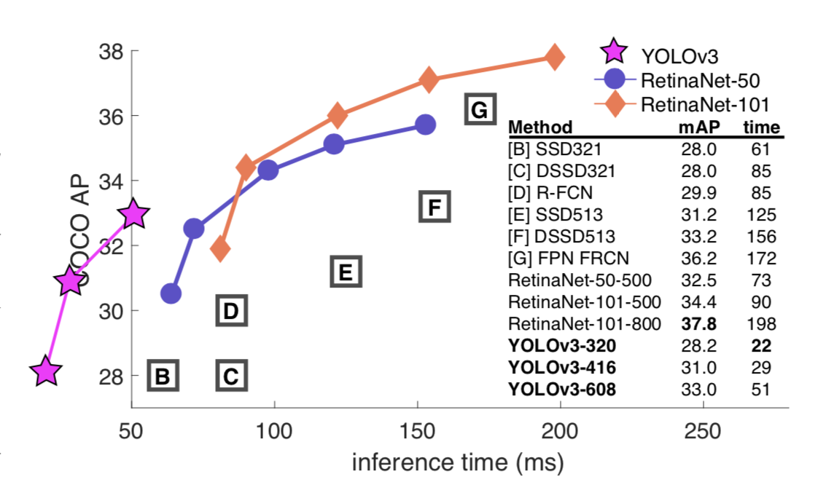
Take a look at results

Slide 3
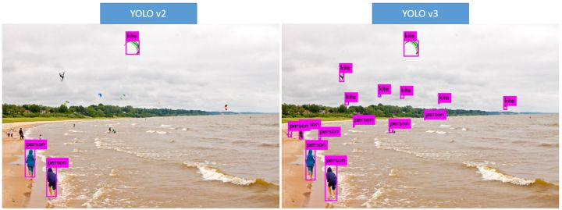
Take a look at comparison of Yolo2 and Yolo3

Slide 4
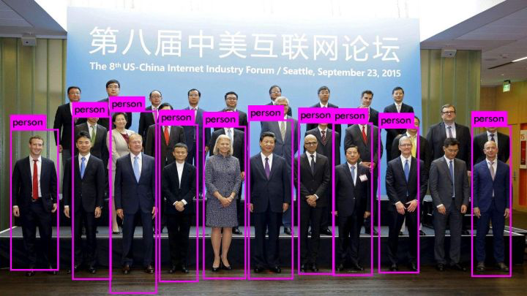
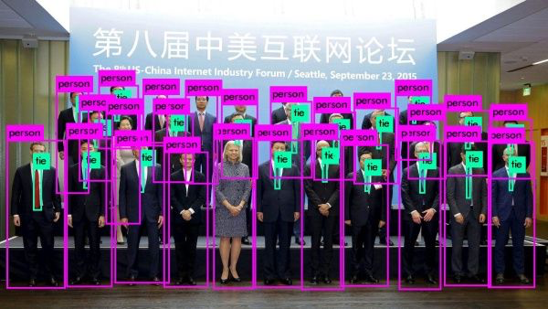
Take a look at comparison of Yolo2 and Yolo3

Slide 5
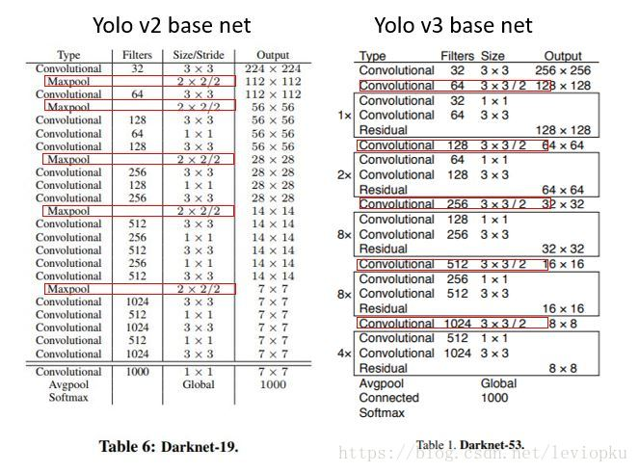
Improvement: Predictions Across Scales

Slide 6
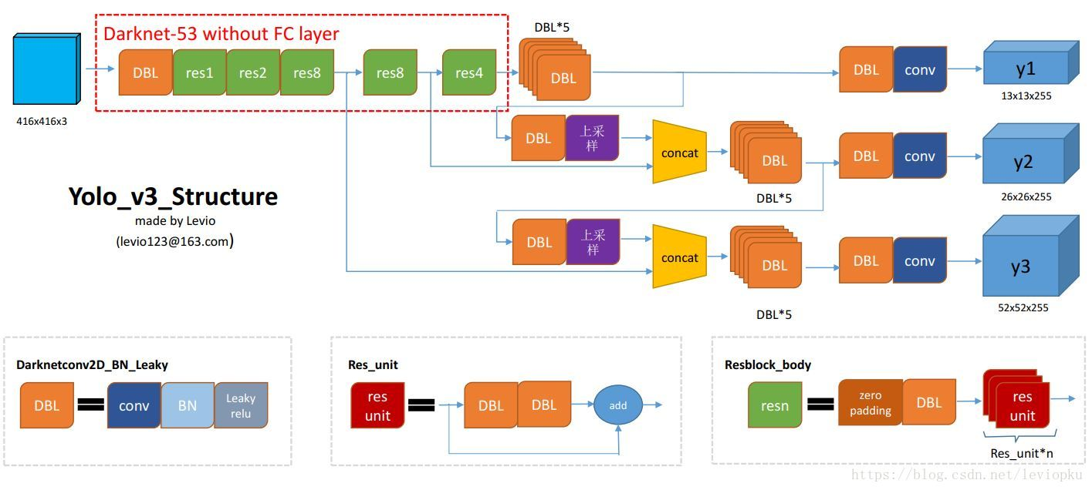
Improvement: Predictions Across Scales
The features actually contain many things, like image features, position coordinates, so i think the features fusion is like a essemble
*https://blog.csdn.net/leviopku/article/details/82660381

Slide 7
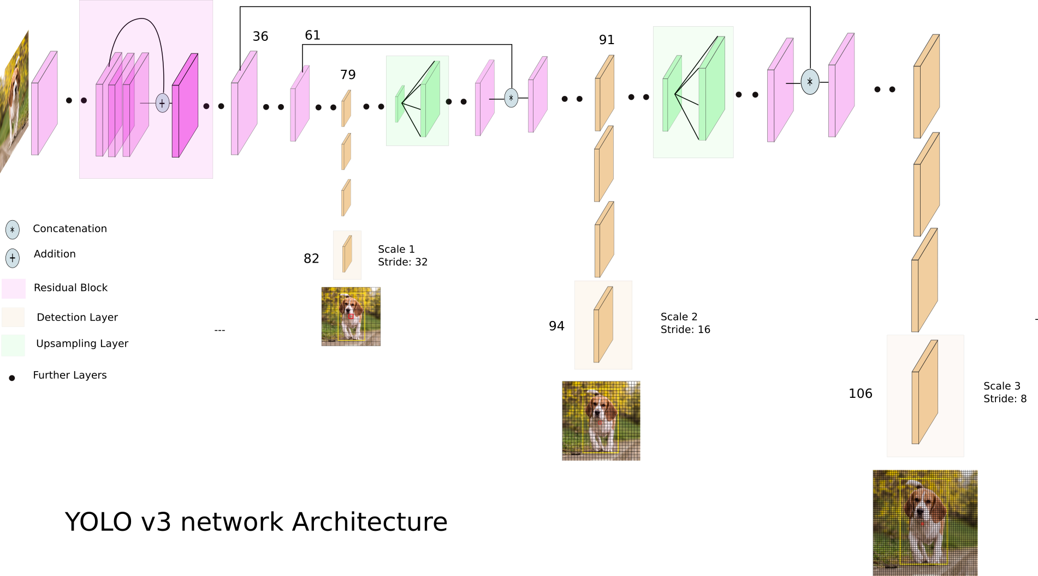
Improvement: Predictions Across Scales
output 13 x 13 grid cell,
every cell predict 3 bounding boxes
output 26 x 26 grid cell
output 26 x 26 grid cell

Slide 8
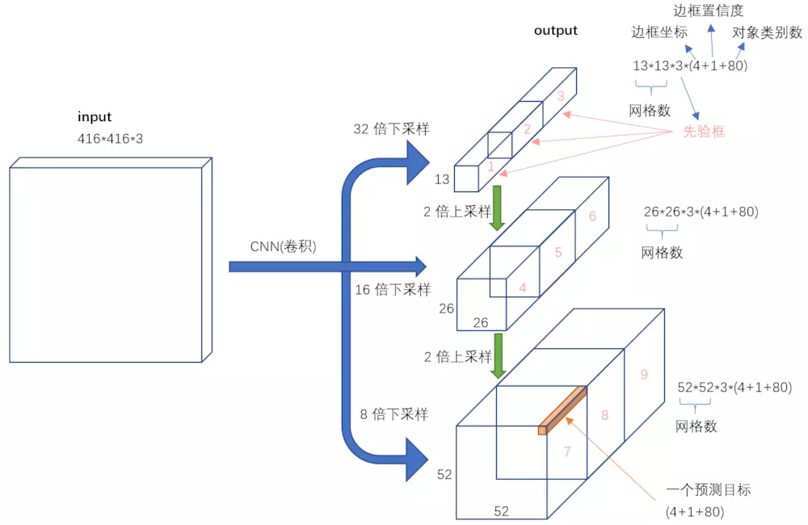
Improvement: Predictions Across Scales
Object confidence threshold: filtering out the bounding boxes that below the confidence threshold
Non-maximum Suppression(Only used on testing )
There are (13*13 + 26*26+52*52)*3 bounding boxes,
how to romove the redundant boxes?

Slide 9
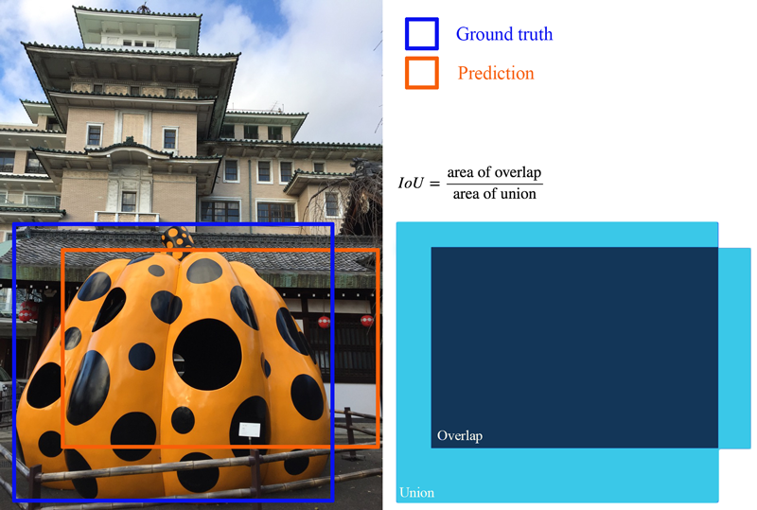
Improvement: multilabel classification
Simple change: replace the softmax with logistic classifiers
Reasons:
overlapped things result only one output
2. One thing with multilables

